Slide 1
Beginning Software Craftsmanship
Brendan Enrick | @Brendoneus
Jeff Valore | @CodingWithSpike

Slide 2
Key Practices
Automated Testing
Continuous Integration
Pairing
Notes:
There are so many practices that you can focus your efforts toward in order to improve the software that you write. I’s never have time to stand up here and tell you about all of them. I’m just going to talk about 3. The first one is one that I’m sure that you’re either trying, have tried, or are doing. Who in this room has dabbled in automated testing? Who has done automated testing on a project?
Who here is able to (or required) to use automated testing at work?
Who here is able to unit, integration, UI, etc. etc. all of their code on their projects?

Slide 3
Automated Testing
Tests are useless when not run
Manual tests are likely to be skipped
Run automated tests constantly
Catch problems before committing

Slide 4
Kinds of Tests
Unit Tests
Integration Tests
UI Tests

Slide 5
Unit Tests
Run in Isolation
Are extremely fast
Can be run constantly
Can afford to have many of them

Slide 6
Integration Tests
Test Interactions
Confirm Infrastructure works as expected
Slower than unit tests
Can be run frequently
Ideally run before each commit

Slide 7
UI Tests
Verify behavior of entire features
Slow, but still automated
Should be defined by customer
May even be written by customer
Ideally run before every commit
May need to run only on scheduled basis on build server

Slide 8

What should we test?
At least one happy path
At least one sad path
Expected Exceptions
Boundary Conditions
Code Contracts and Invariants
Test all code paths
100% test coverage is useless if it doesn’t account for Cyclomatic Complexity

Slide 9
Why do we test?

Slide 10
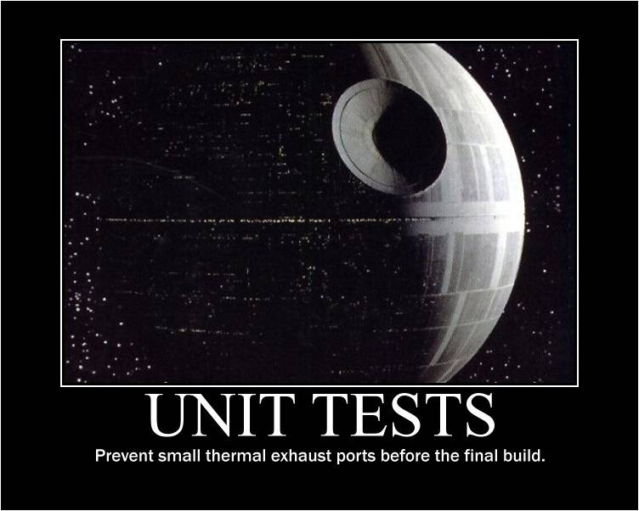

Slide 11


Slide 12
Arrange – Act - Assert
Arrange
Set up the test’s initial state
Act
Perform the action you wish to test
Assert
Inspect the system or results for correctness

Slide 13
Two Typical Approaches
State-Based Tests
Given inputs, I expect output
Black box; we don’t care how output produced
Behavior-Based Tests
Concerned with workflow, actions performed
White box; cares how things are done within the system
When I call A, I expect it to call B and C
Frequently disregards state/result of operations

Slide 14
Why is testing hard?
Dependencies
Databases
File systems
Web Services
Clocks
Emails
Notes:
Depending on infrastructure concerns directly makes testing difficult. Introduce and depend on abstractions to keep testing easy and fast.

Slide 15
Decouple
Inject dependencies
Replace hard-to-test code with
Fake objects
Mock objects
Unit tests should only run your code
Notes:
Unit tests should not run database code, filesystem code, web service code, etc. They should only run the code in the system under test, and they shouldn’t use any system resources except cpu and ram.

Slide 16
Test Driven Development
Red
Create a very small failing test.
Refactor
Clean up the “easy” code and the test.
Green
Get a green in the easiest way possible.

Slide 17
Naming Tests
Complete the sentence
Class: SystemUnderTestMethodAShould
Test: ReturnFalseGivenInputB
Test: ReturnTrueGivenInputC
Avoid:
UnitTest1.cs
Test1
Test2
CustomerTests.cs
PurchaseTest

Slide 18
Continuous Integration
Build solution on a separate machine
Build directly from what is in source control
Trigger build on every source commit
Ensures code in source control can run
Ensures code doesn’t just work on your machine

Slide 19
Pairing
Involves two minds, not four hands
Collaborative effort
Quality improves; quantity of non-mundane tasks improves as well
Provides immediate feedback
Bugs
Design decisions
Constant code review

Slide 20
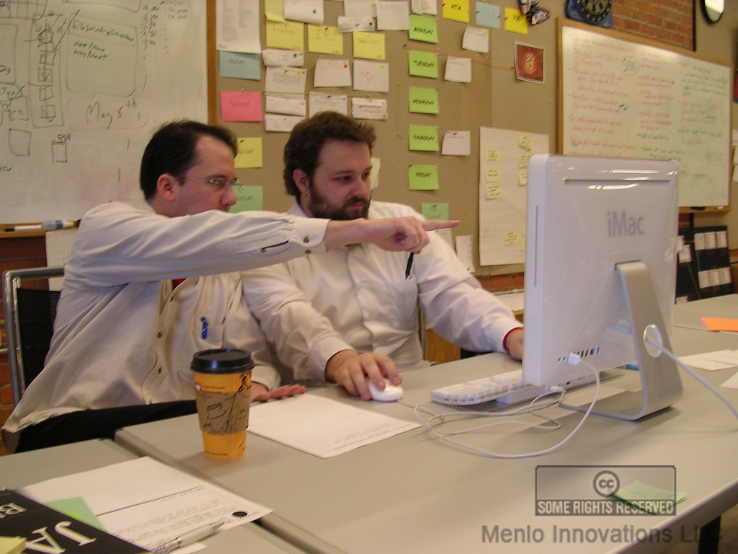
http://www.flickr.com/photos/menlopics/3928250043/

Slide 21

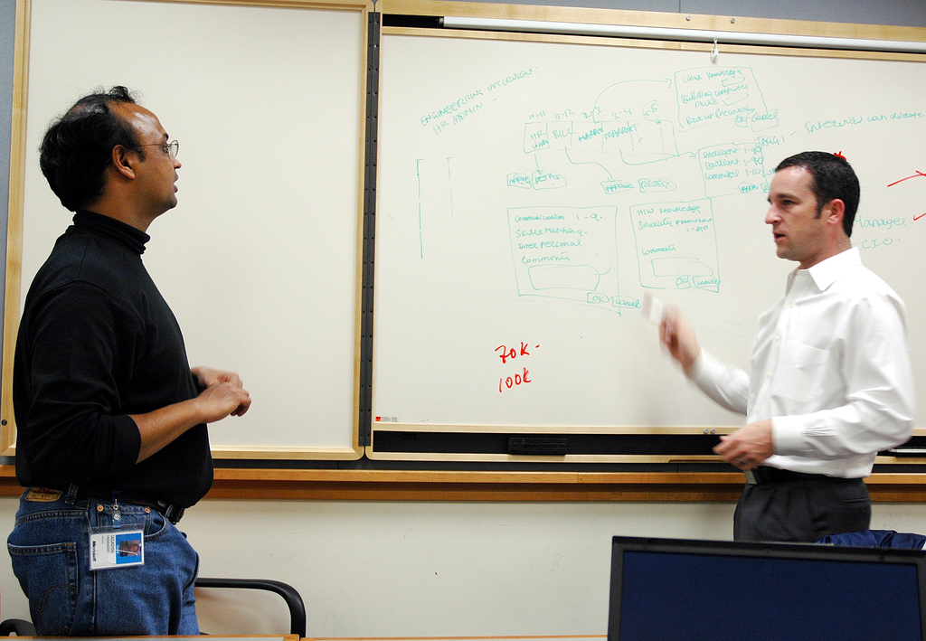
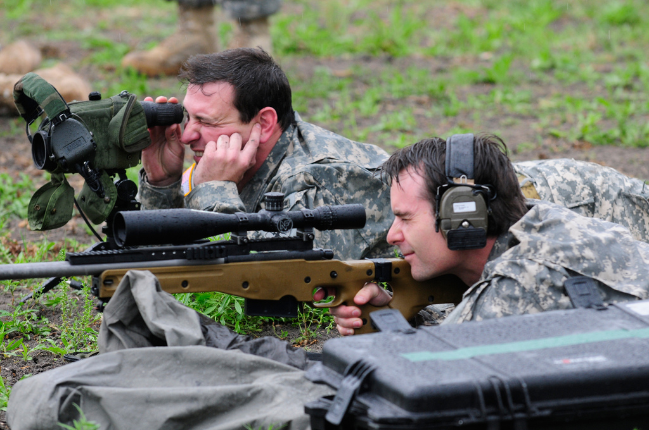



Who Pairs?
http://www.flickr.com/photos/isafmedia/4990043858/
http://www.flickr.com/photos/thenationalguard/4535036556/
http://www.flickr.com/photos/flyforfun/3264854289/
http://www.flickr.com/photos/bestinplastics/4893299962/
http://www.flickr.com/photos/wonderlane/315466291/
Notes:
Snipers
(Jeff Gordon in 2nd picture)
Pilots and Copilots
Doctors
Us – at the whiteboard
Us – at the keyboard

Slide 22
Common Concerns
“My partner is too slow”
Learn patience
Switch partners frequently
Be a mentor
Learn to type competently (if that’s the issue)
Notes:
Typing is a fundamental skill for software developers. It’s not necessary that you be among the world’s fastest typists, but neither should you be among the slowest. If you cannot type competently, it reflects poorly on your capabilities and attitude toward your profession and work. This is a tool you use every day!

Slide 23
Pair Programming
A social skill that takes time and practice
Not mentoring, but two developers working together as equals
Of course, working together at a computer is also a great mentoring practice

Slide 24
How
Best with co-located teams
Best with suitable space and furniture
Try to create a team room
Remove walls, cubical furniture
Avoid L- and U-shaped desks

Slide 25
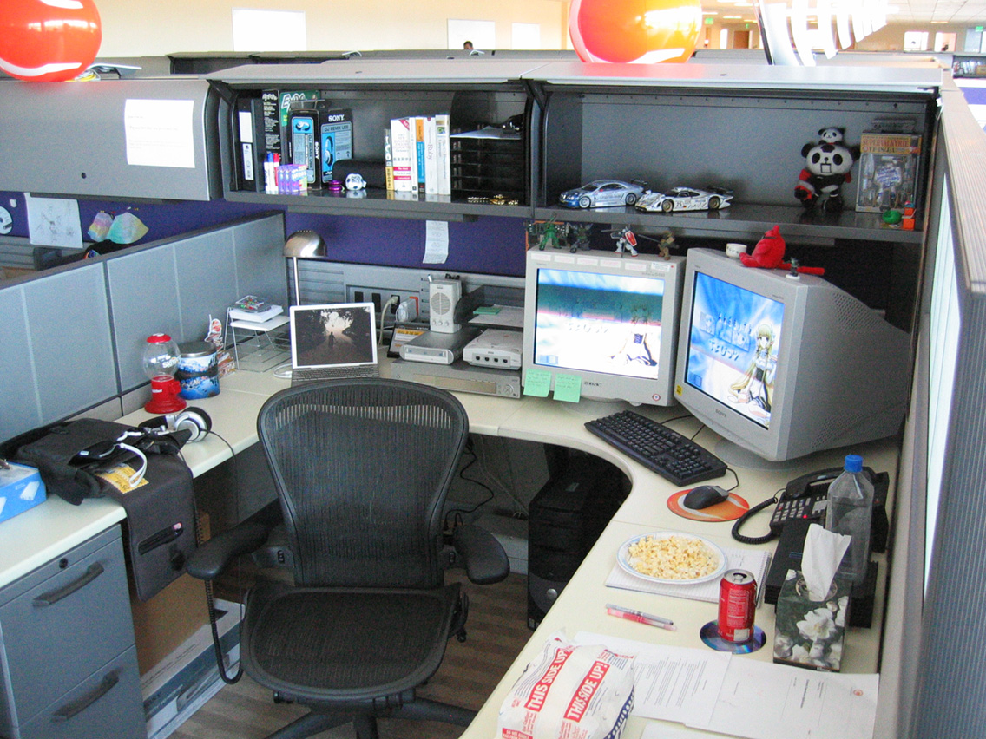
http://www.flickr.com/photos/halfaloafoftofu/413474322/
Notes:
A typical cubicle setup. How are you going to get two chairs in here?

Slide 26
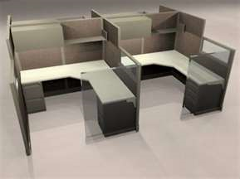
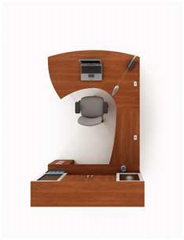
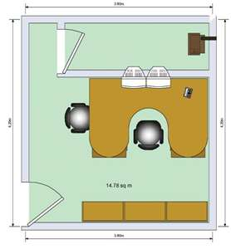
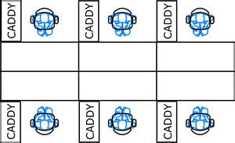
More Bad Layouts
Notes:
Some more bad layouts for pair programming.

Slide 27
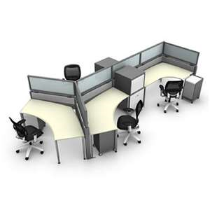

Better Layouts

Slide 28

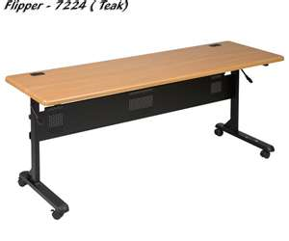
Ideal Layouts - Tables

Slide 29
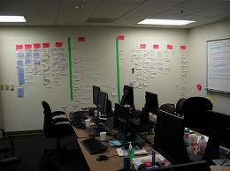
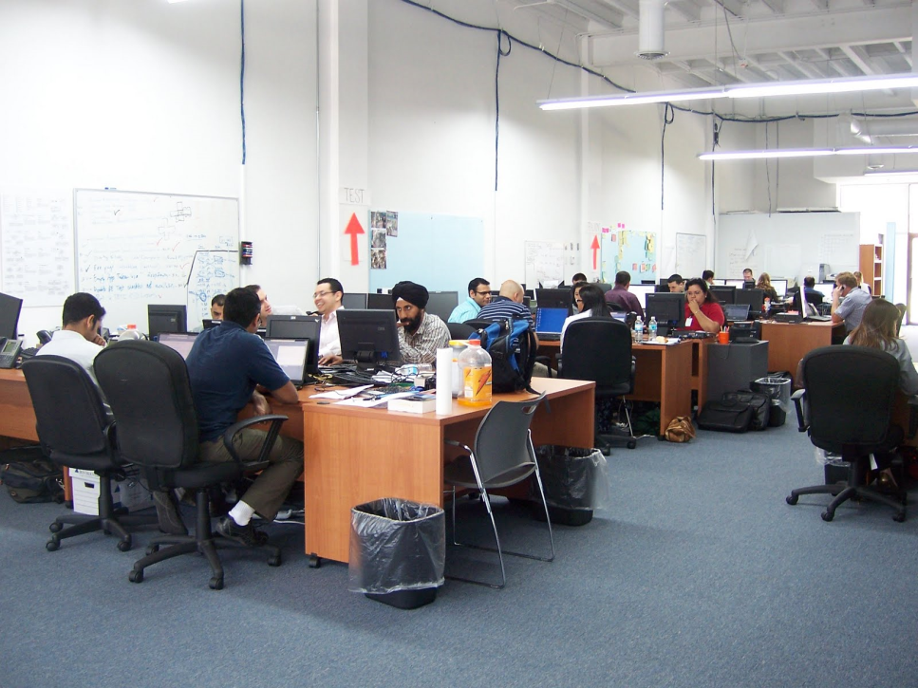
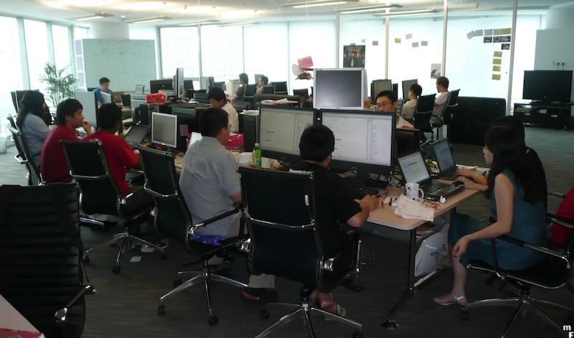
Team Rooms
Notes:
The best setup is an open bullpen, with little cubbies around the outside of the space. The team members can keep their personal items in these cubbies, go to them to make phone calls, and spend time at them when they don't want to be interrupted. [...] Put the biggest, fastest development machines on tables in the middle of the space (cubbies might or might not contain machines). This way, if someone wants to program, they will naturally be drawn to the open public space. From here everyone can see what is happening, pairs can form easily, and each pair can draw from the energy of the other pairs who are also developing at the same time.
http://c2.com/cgi/wiki?CaveAndCommons

Slide 30
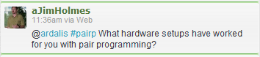
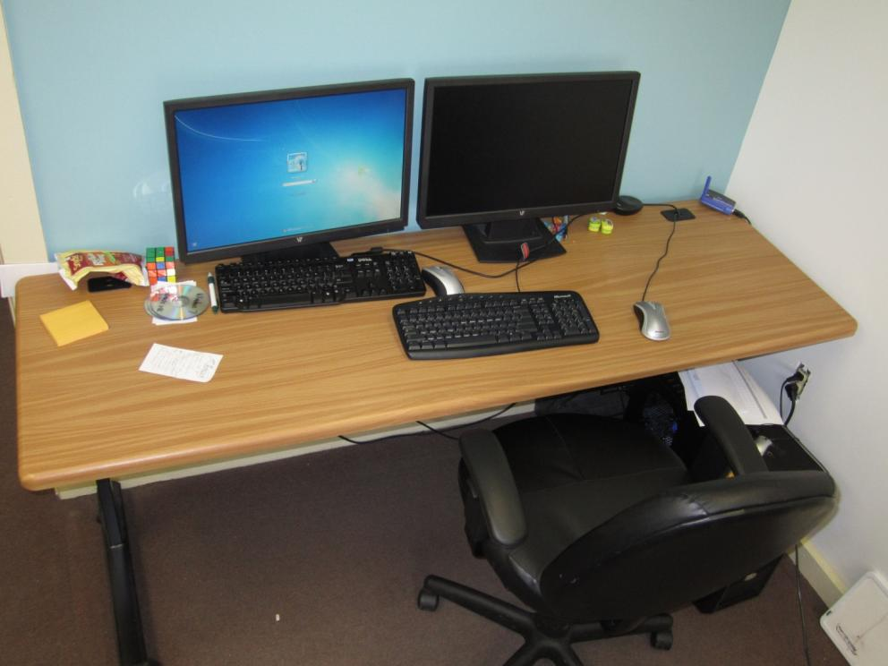
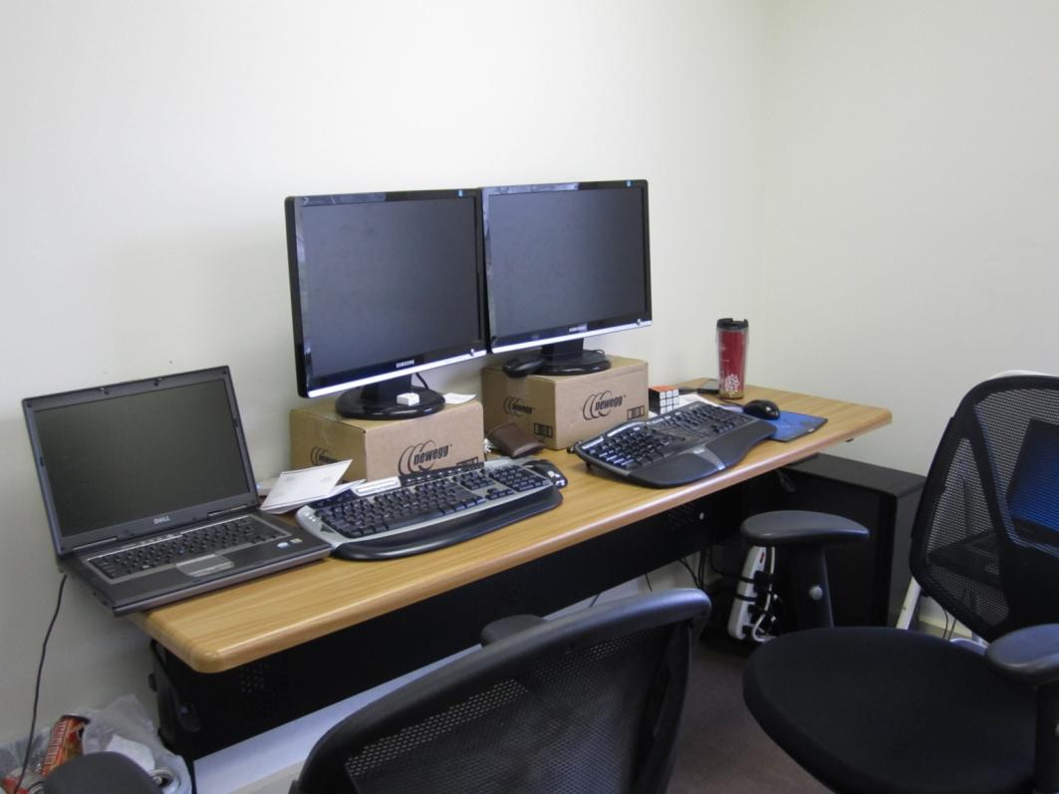
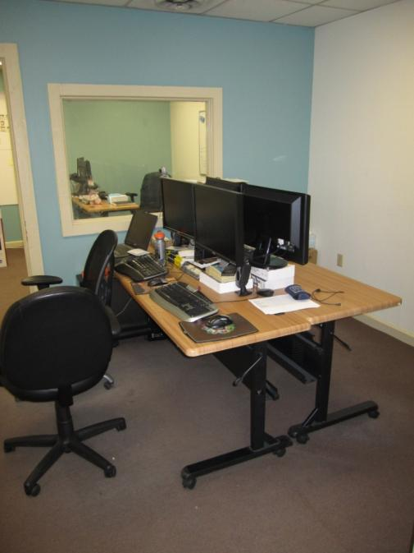
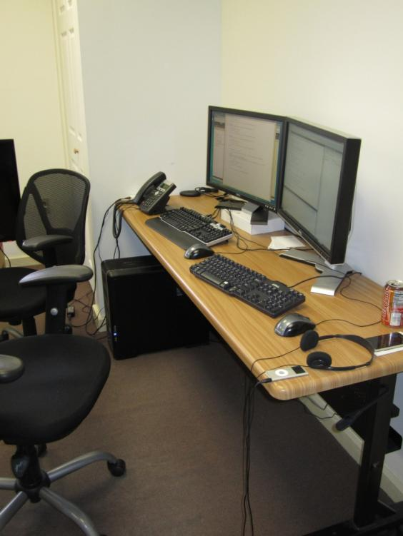
Pair Workstations
Notes:
Back to back
Enough room for 2 keyboards and 2 mice
Room for a laptop on the end so navigator can look something up, ask a question online, etc. while pilot keeps writing code

Slide 31
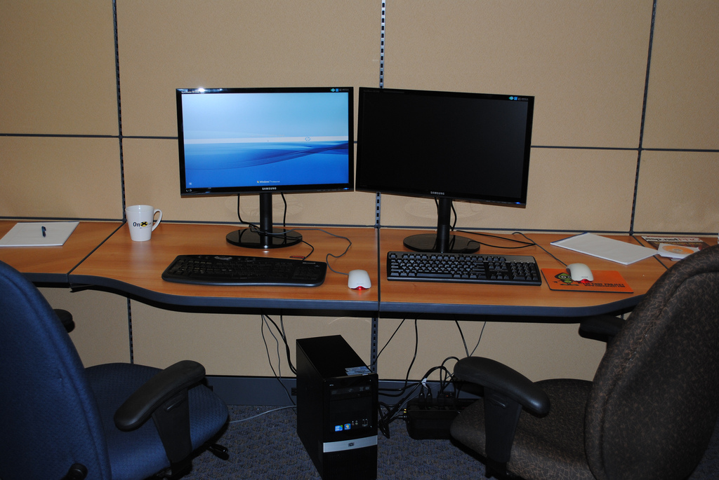

Slide 32
When does pairing work best?
Complex code
Mission-critical code
Code that involves design decisions
Areas of code everyone should understand
Notes:
Avoid silos
Your truck number (or bus, or lorry, or lottery) is equal to the number of developers who would have to be hit by a truck in order for the development team to lose some skill or piece of information critical to the successful implementation and maintenance of the project.

Slide 33
You already do this!
When you ask for help with a tricky bug
When you run a new design by a teammate
When you have someone doublecheck that scary database update script
You know it works

Slide 34
When shouldn’t you pair?
Mundane tasks
Fixing simple typos
Spike solutions
When distracted
Checking email, social media
When you’re sick!
Don’t infect others!

Slide 35
When do you switch roles?
Every so many minutes
After each test is written and passing
Whenever one of you gets stuck

Slide 36
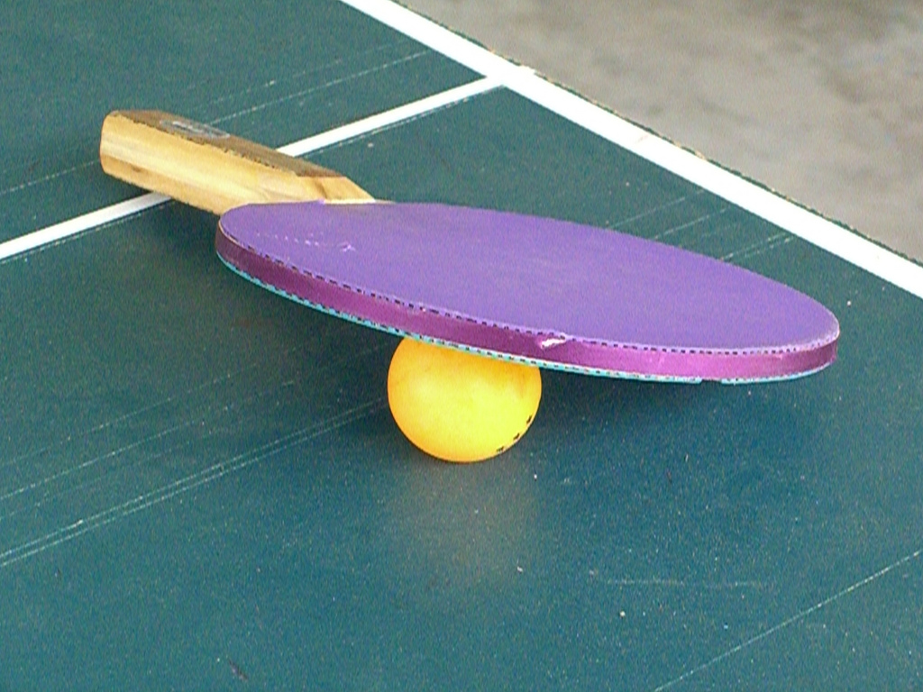
Ping Pong Pairing

Slide 37
Ping Pong Pairing
Alice (Pilot) write a failing test [switch roles]
Bob (new Pilot) writes smallest amount of code possible to make test pass
Bob refactors if needed (with input from Alice)
Bob writes a failing test for the next bit of functionality [switch roles]

Slide 38
Benefits of Pairing
Better code
Knowledge sharing / transfer
More fun
Higher productivity / fewer distractions
Improved communication
Higher truck factor

Slide 39
More Benefits
Continual review
Improved design
Fewer defects
Rapid integration of new team members
Fewer information silos

Slide 40
Pairing Tips
Collaborate and respect one another
Set up an effective work area for two
Alternate roles frequently
Stay engaged and communicate frequently
Think out loud
Wait 10 seconds before pointing out every typo
Avoid driving your partner crazy

Slide 41
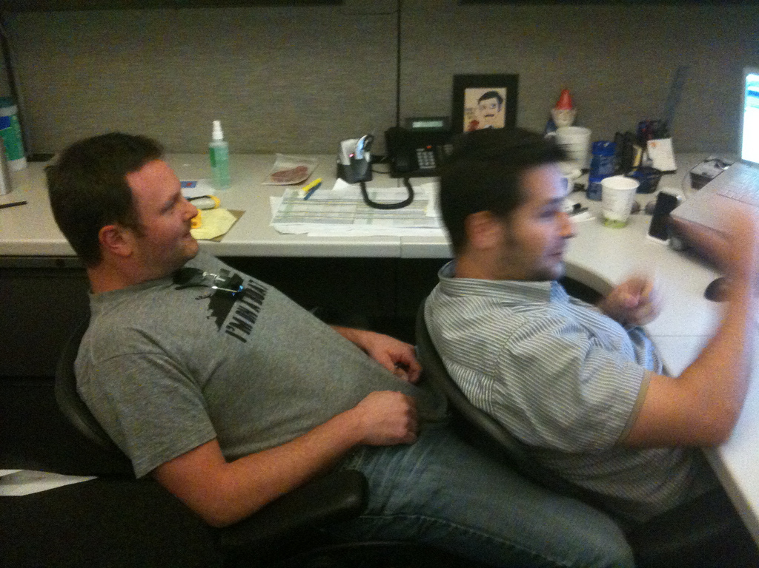
You’re Doing It Wrong
http://www.flickr.com/photos/shadowstorm/3985346700

Slide 42

Discuss

Slide 43
Thank you!
Brendan Enrick
@brendoneus
brendan.enrick.com
Jeff Valore
@CodingWithSpike

